Slide 1
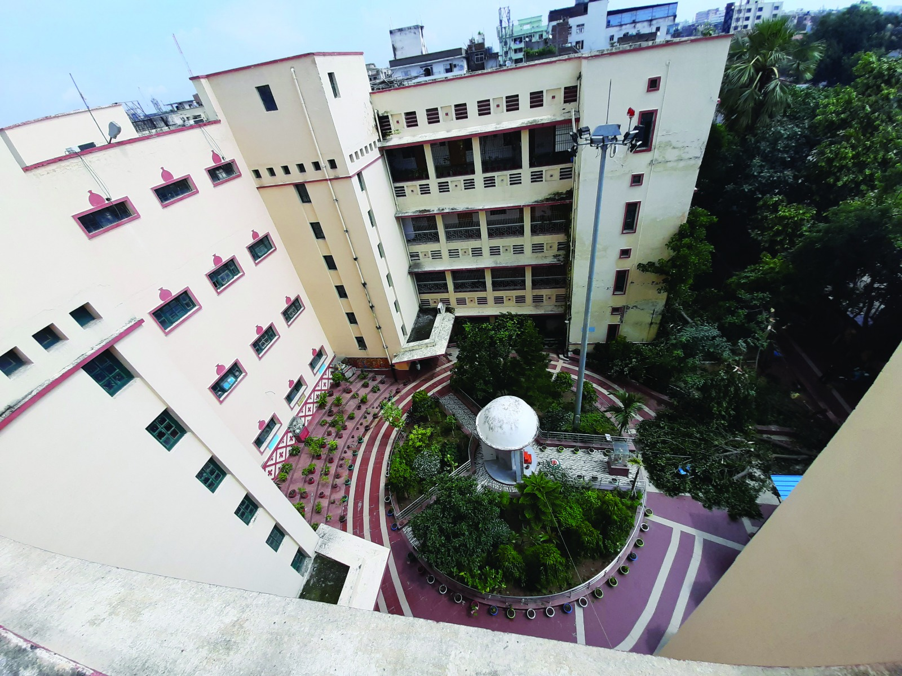
GOVERNMENT AYURVEDIC COLLEGE PATNA

Slide 2
The government ayurvedic college, Patna is a top – notch hub for ayurvedic education in India. with its roots dating back to July 1926. during the pre-independence era.
Our faculty is the backbone of this institution, comprising over 80 experienced and dedicated teachers who also serve as consultants in our top-notch hospital. Speaking of the hospital, it's fully equipped and even boasts its own pharmacy
It has glorious past and produced numerous scholars who have achieved various key positions and showed theirs treasure of knowledge and across the India , some names like Priyavrata Sharma a renowned vaidhya in famous world wide for his contribution and was the principal of this college.

Slide 3
Many Alumunii of this college presently holding key position in various prestigious ayurvedic institution like AIIA,
NIA, BHU, CHAUDHARY BRAHM PRAKASH and many state college across the country.
Some of them propagating ayurvedic fundamentals to the world and has been brand ambassador for propagating ayurveda world wide is alumii of this college as well.

Slide 4
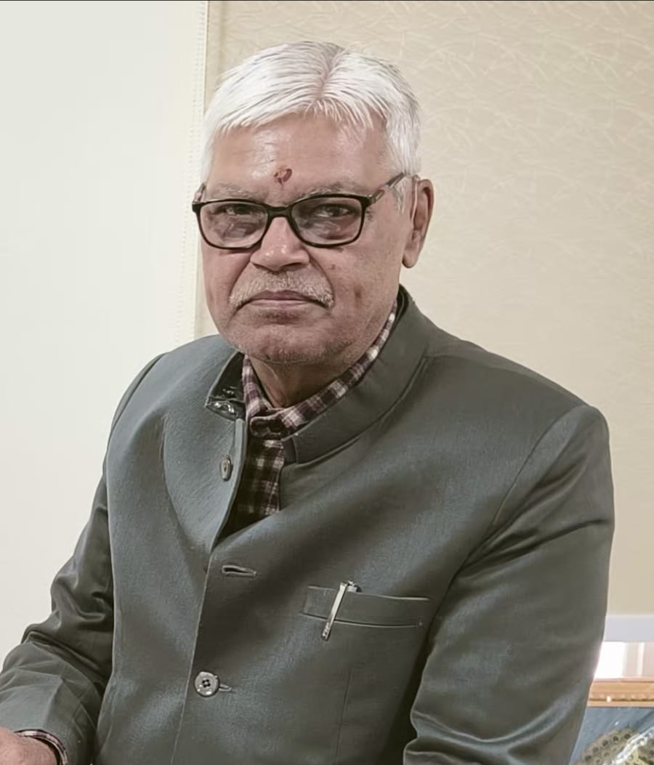
PRINCIPAL – DR.(PROF) S.N.TIWARI
QUALIFICATION – G.A.M.S, M.D (DRAVA GUNA NIA JAIPUR)
DEAN AYUSH (BIHAR HEALTH UNIVERSITY SINCE 2 YEARS)
VISIONARY DYANMIC AND ENTHUSIATICS PERSONALITY DEDICATED FOR GROWTH OF AYURVEDA
WILLING TO ACCOMPLISH NEW OPPURNITY AND CHALLENGES
A GOOD TEAM LEADER & UNBIASED PROVIDE OPPURNITY TO ALL THE EMPLOYEES FOR THEIR INDIVIDUAL GROWTH
BELIVE IN EQUAL GROWTH OF ALL THE EMPLOYEES

Slide 5
TOTAL DEPARTMENT – 14
(1)Kaya Chikitsa (Ayurvedic Medicine)
(2) Shalya Tantra (Ayurvedic General Surgery)
(3) Shalakya Tantra (Ayurvedic ENT & Opthalmology)
(4) Sanskrit, Samhita and Siddhanta (Ayurvedic Basic Principles)
(5) Prasuti Tantra & Striroga (Ayurvedic Obstetrics & Gynaecology)
(6) Bala Roga (Ayurvedic Pediatrics)
(7) Pancakarma (Ayurvedic Physiotherapy)
(8) Swasthavritta & Yoga (Ayurvedic Preventive & Social Medicine & Yoga)
(9) Dravyaguna (Ayurvedic Pharmacology)
(10) Rasashastra & Bhaisajya Kalpana (Ayurvedic Rejuvenative & Pharmaceutical Science)
(11) Agada tantra & Vidhi Shastra (Ayurvedic Toxicology & Forensic Medicine)
(12) Roga Nidan & Vikriti Vigyan (Ayurvedic Dignostic & Pathological Science)
(13) Rachana Sarir (Ayurvedic Anatomy)
(14) Kriya Sarir (Ayurvedic Physiology)

Slide 6
TOTAL NO. OF TEACHING STAFF – 60
TOTAL NO. OF NON TEACHING STAFF – 70
NO. OF SEATS PERMITTED BY NCISM/MINISTRY OF AYUSH
UNDER GRADUATE | POST GRADUATE
113 | 77

Slide 7
TOTAL NO. OF STUDENTS STUDYING IN
TOTAL NO.OF INTERNS -28
YEAR | 2023-24 | 2022-23 | 2021-22 | 2020-21 | 2019-20
UG STUDENT | 113 | 125 | 125 | 125 | 100
PG STUDENT | 77 | 85 | 85 | 48 | 48

Slide 8
VARIOUS ACTIVITYIES GOINING 0N IN ROUTINELY
CAMPS
DEBATES
SYMPOSIUMS
WORKSHOP
WEBINARS
POSHAN PAKHWADA
BREAST FEEDING WEEK
SWARN PRASHANA

Slide 9
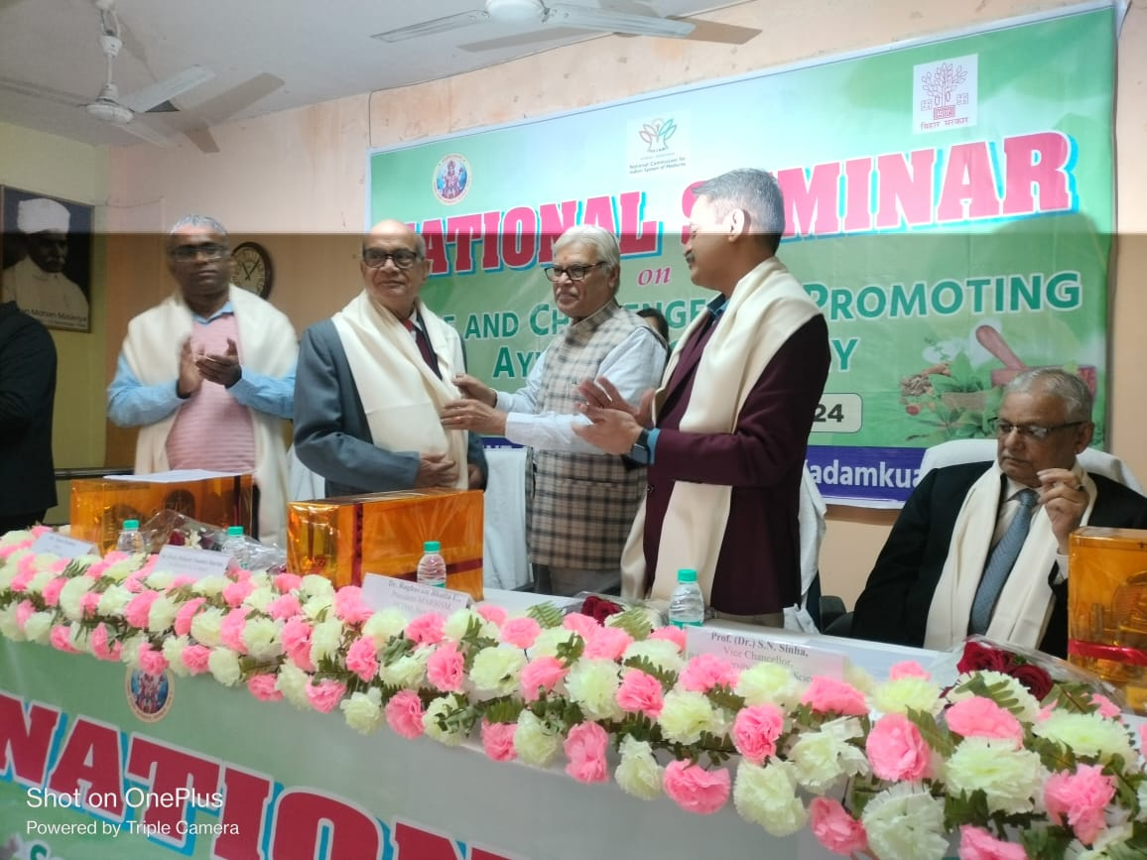
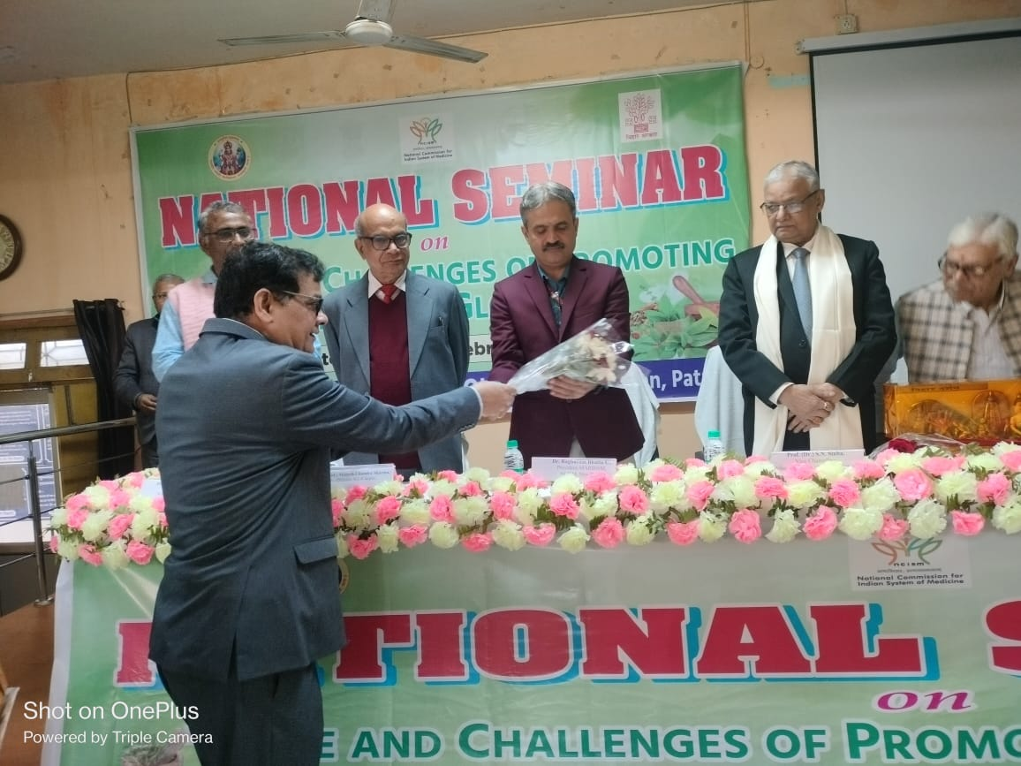
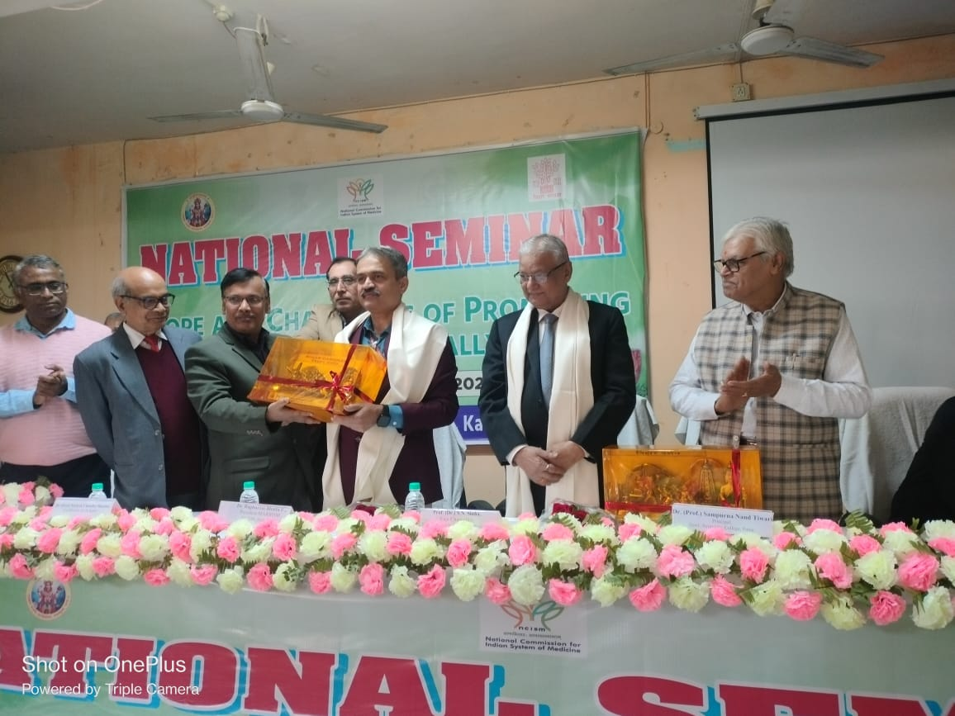
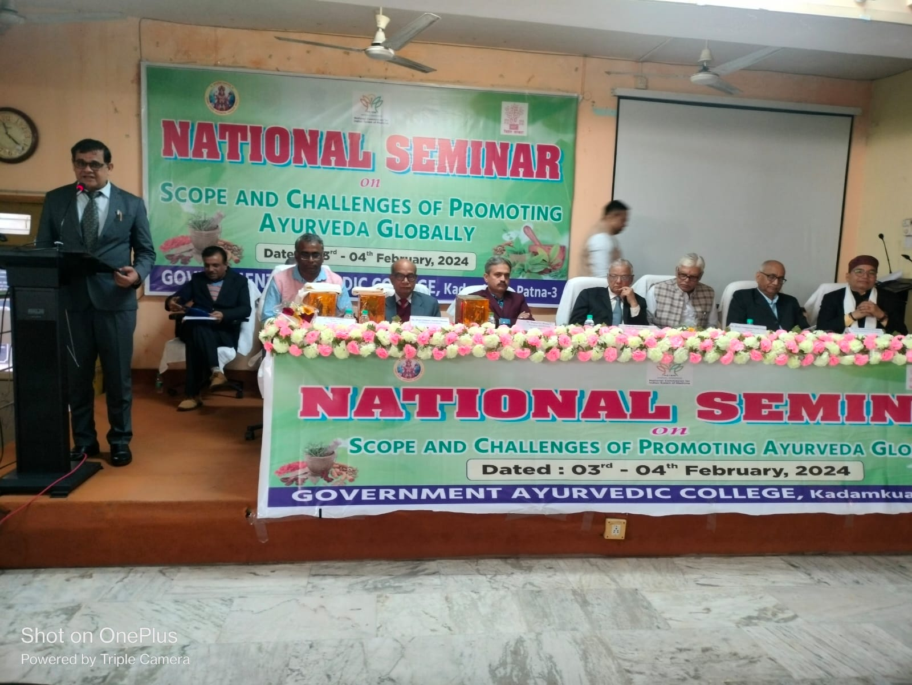
SEMINAR
INSITUTIONAL ACADEMIC SEMINAR-14
NATIONAL SEMINAR-02
DEPARTMENTAL SEMINAR
DEPTT SEMINAR | WEEKLY | MONTHLY | YEARLY
14 | 28 | 96 | 1344

Slide 10
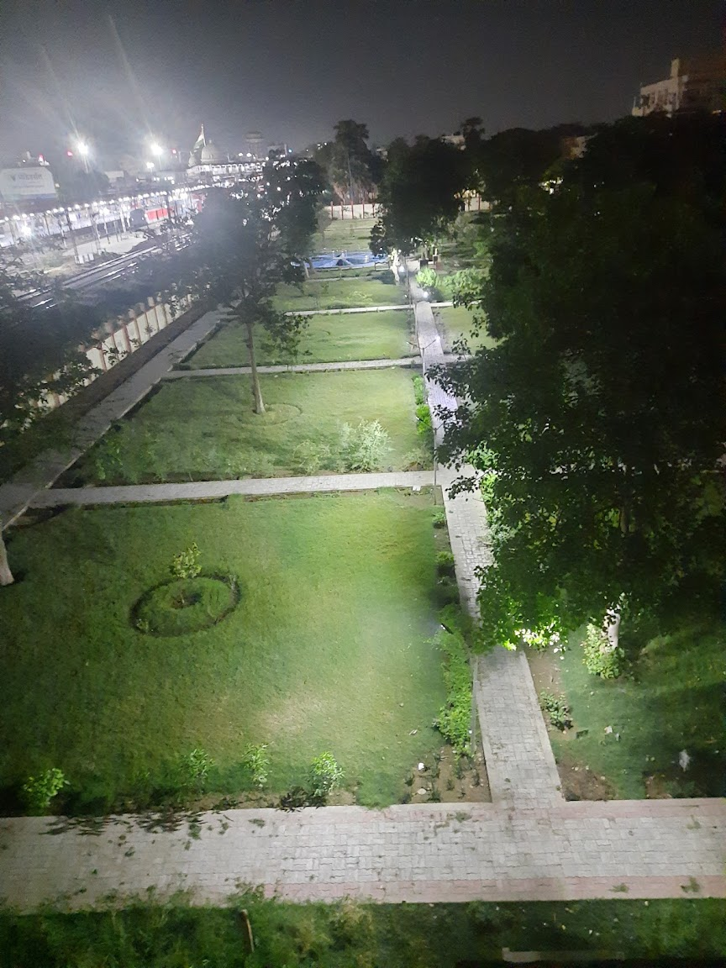
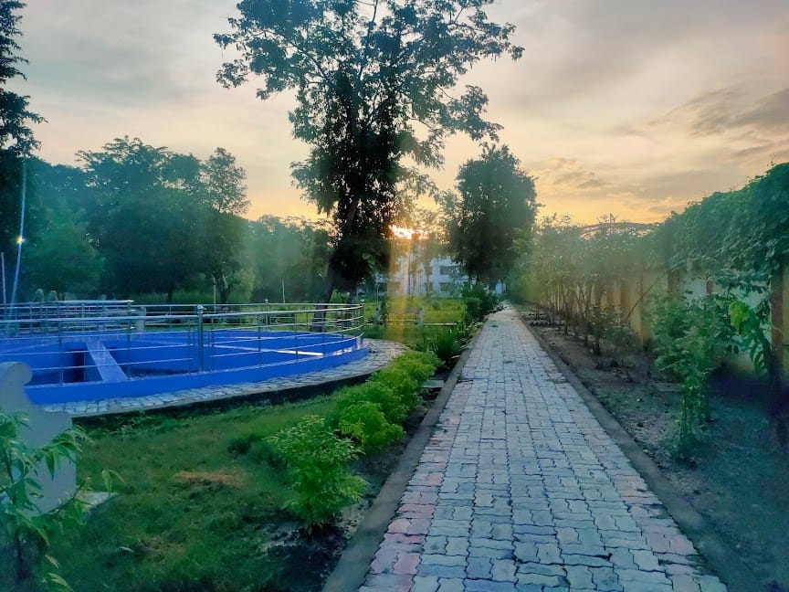
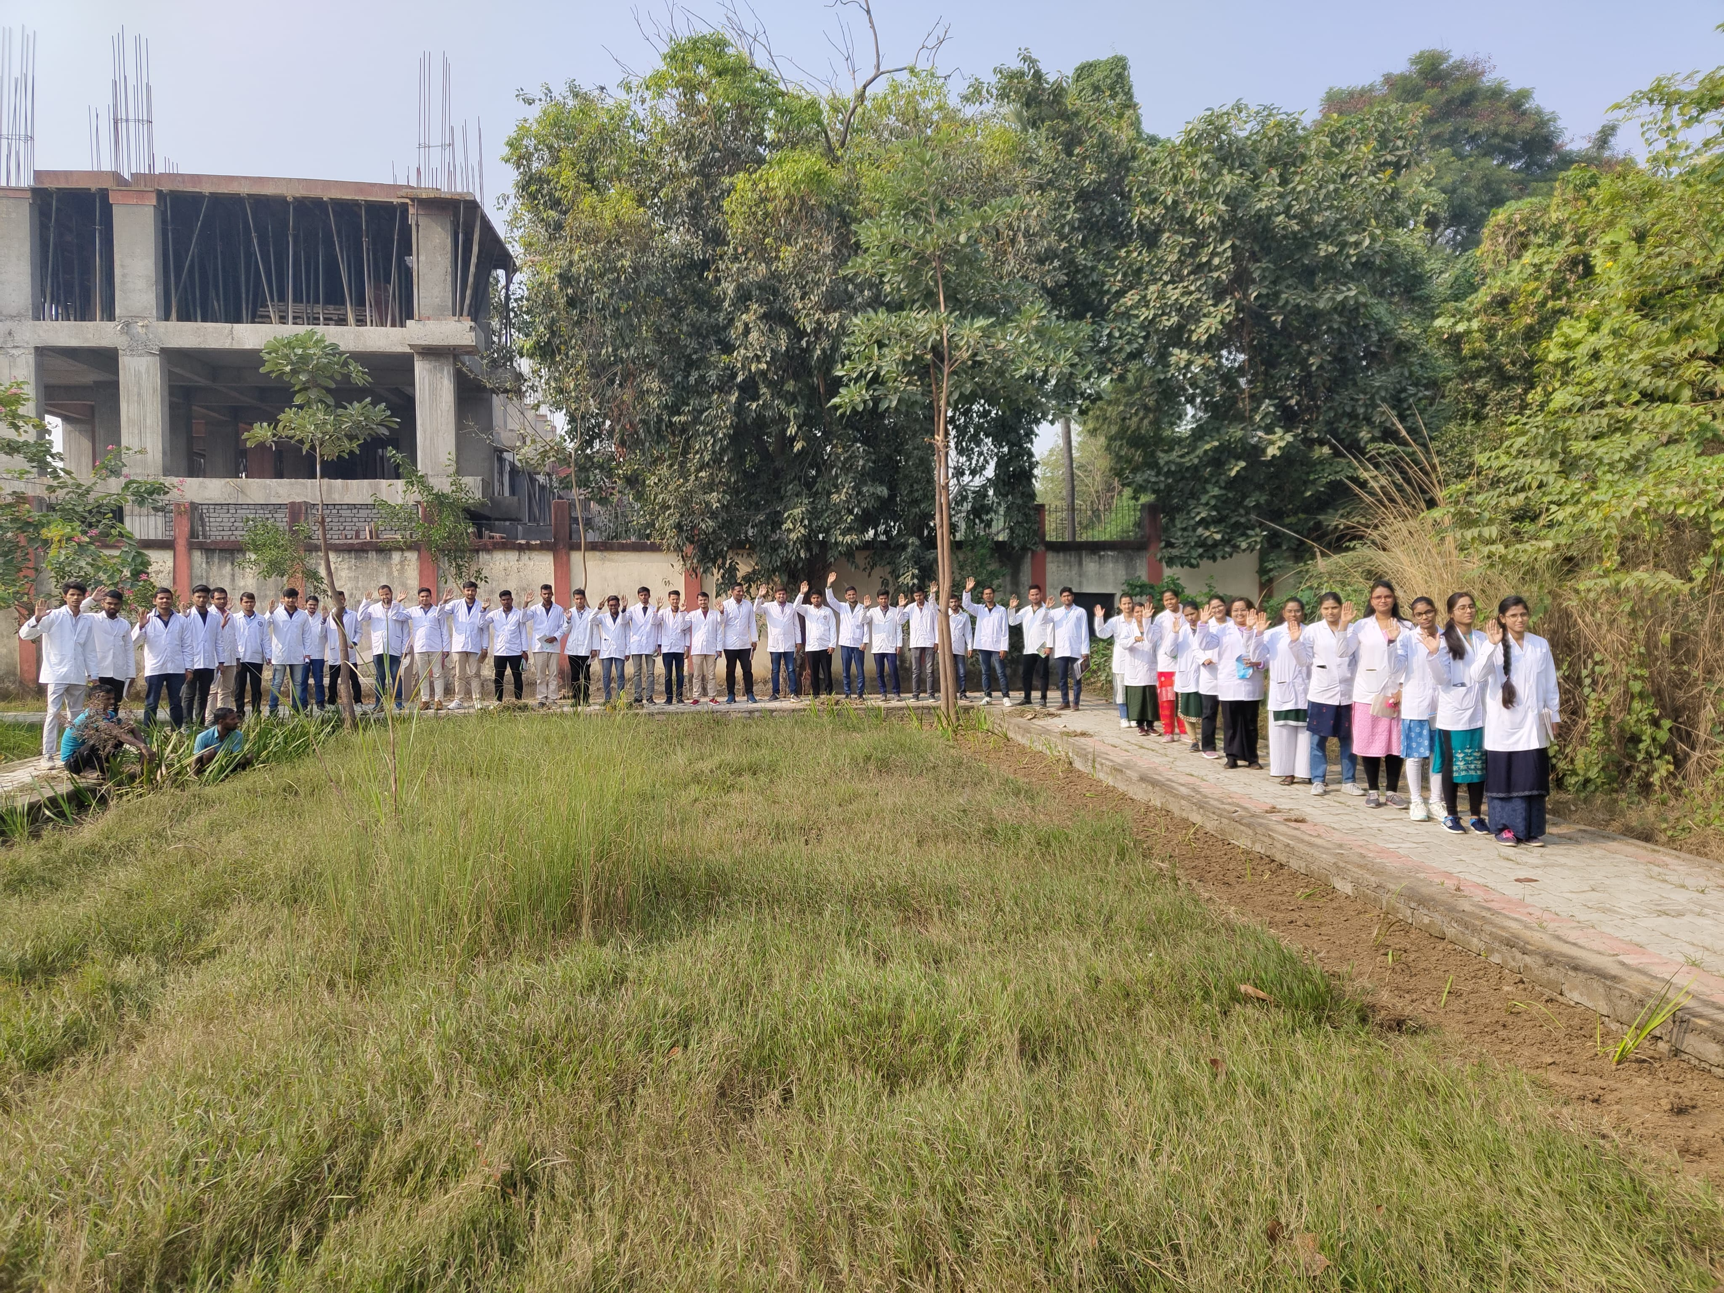
HERBAL GARDEN
AREA | 4000Sqft
NUMBER OF MEDICINAL PLANT | 3703
NUMBER OF PLANT SPECIES | 275

Slide 11
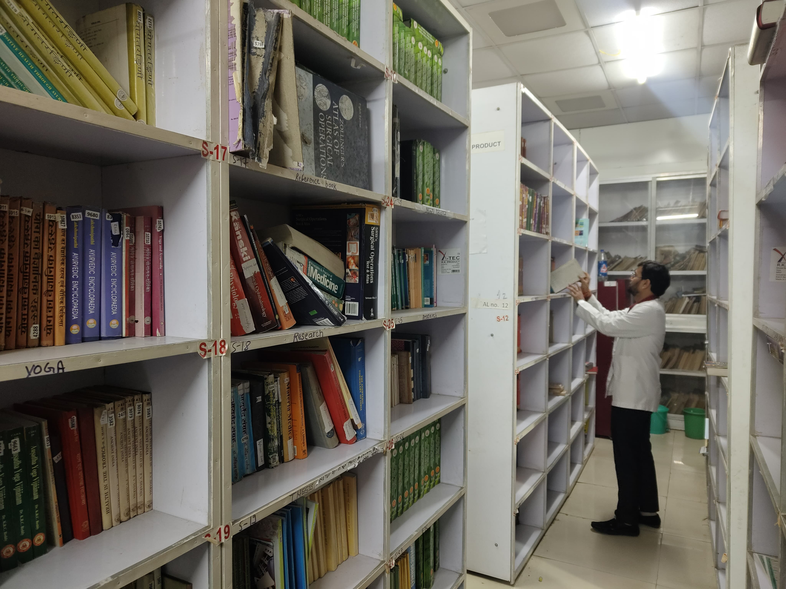
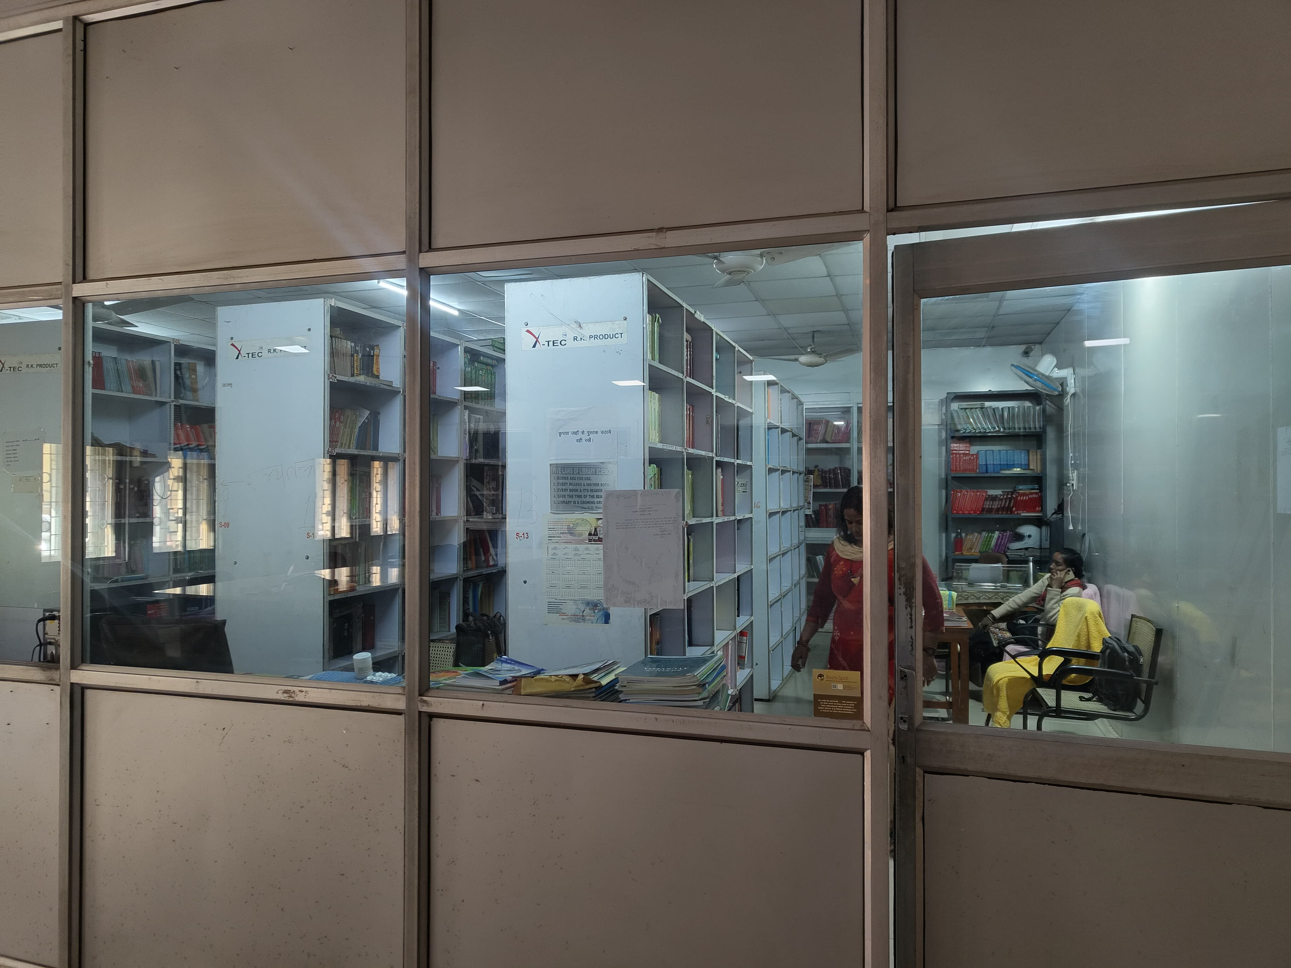
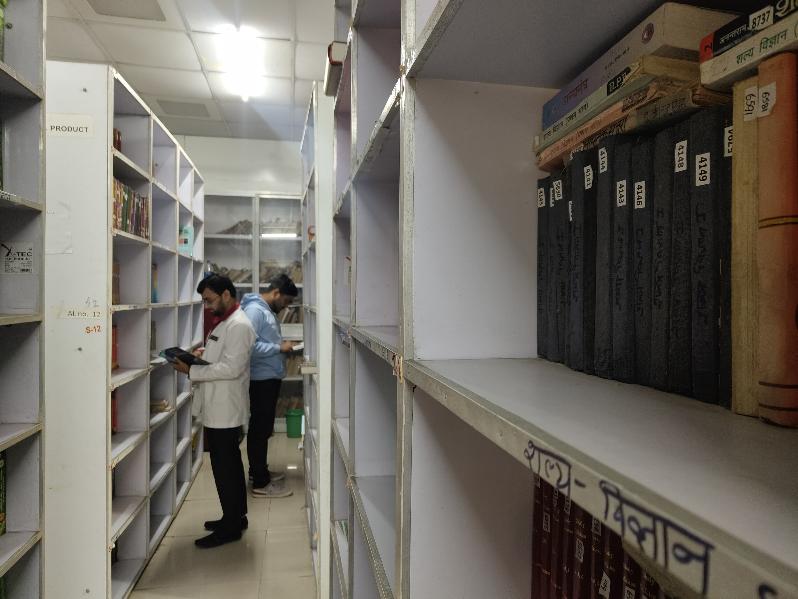
LIBRARY
TOTAL NUMBER OF BOOKS | AYURVEDA | MODERN | JOURNAL | OTHERS
15202 | 11816 | 2890 | 225 | 271

Slide 12
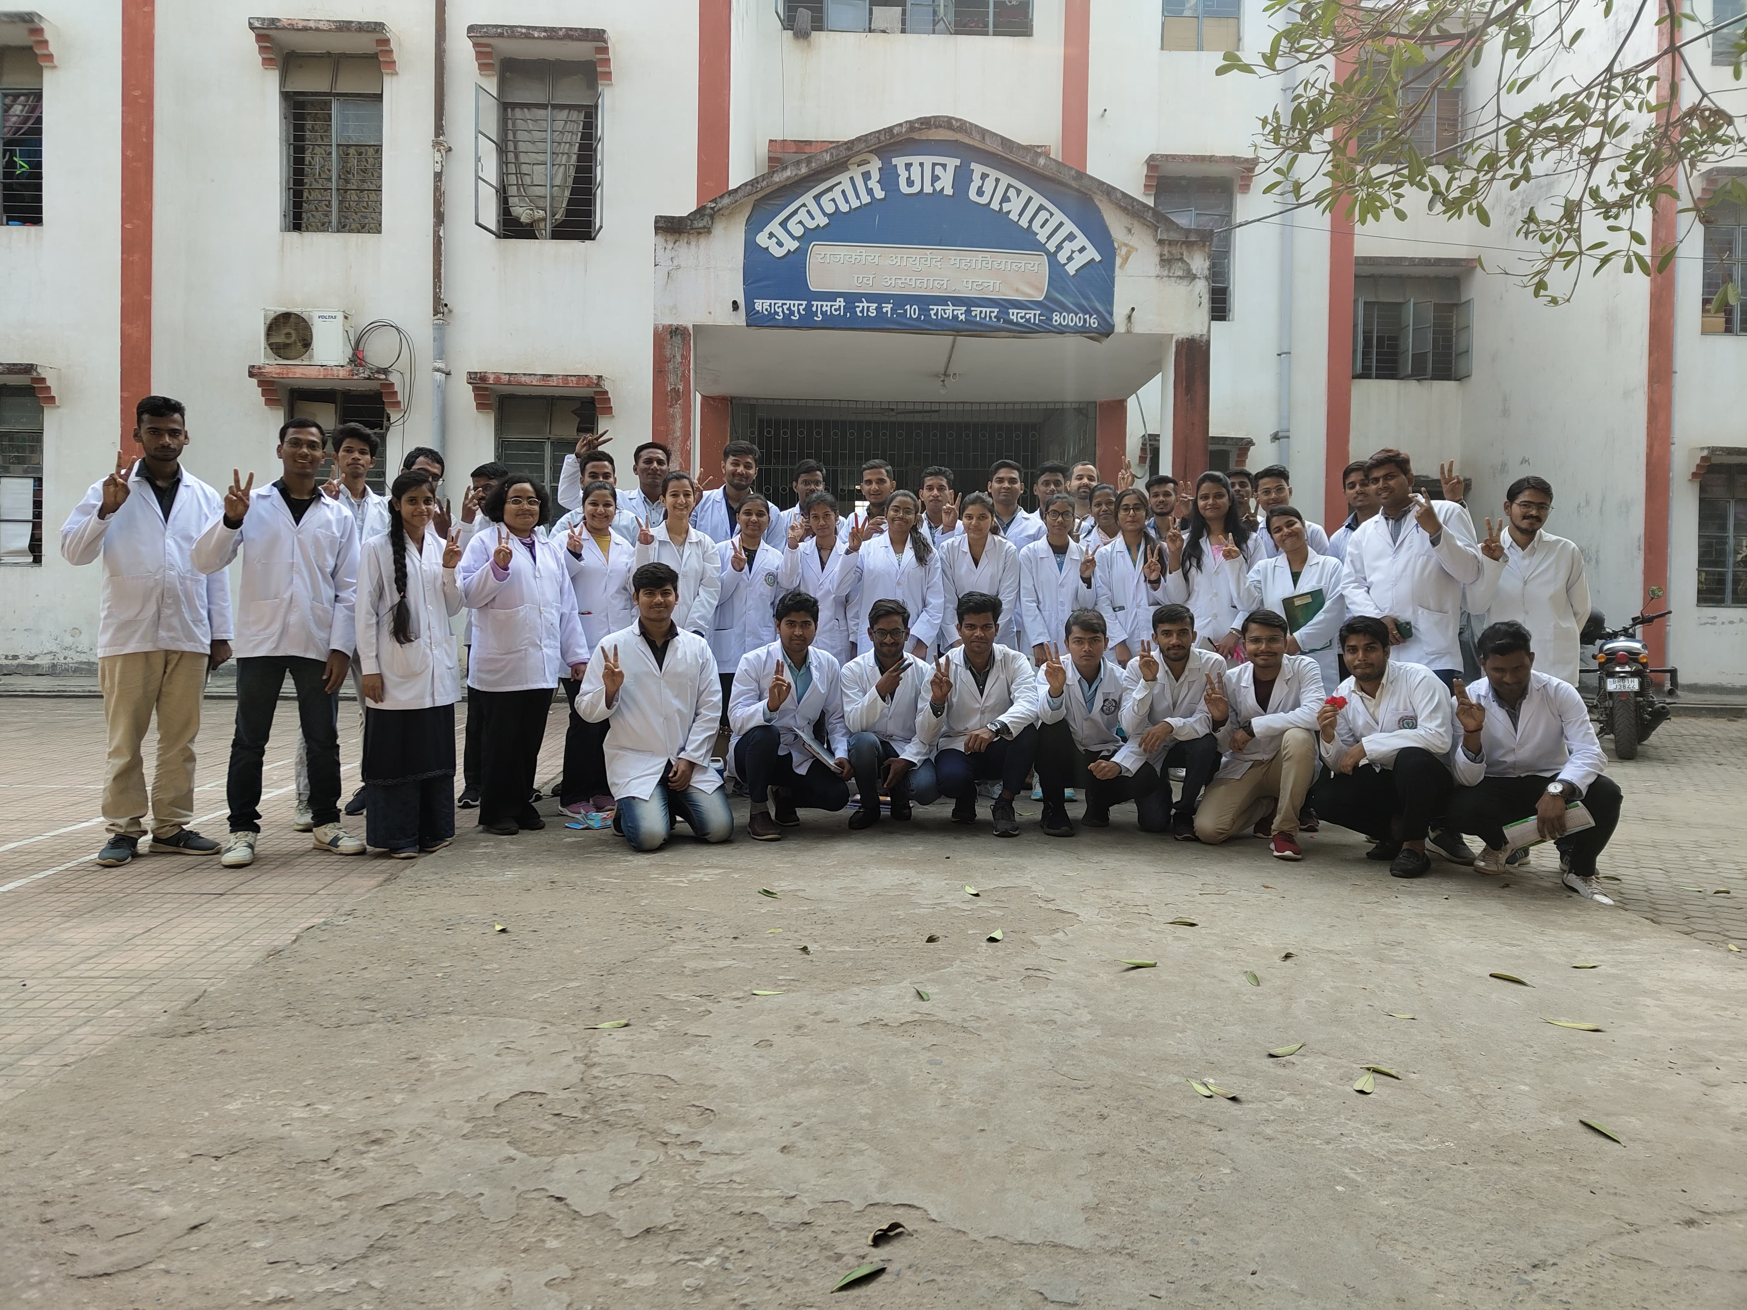
SEPRATE FACILITY OF BOYS AND GIRLS HOSTEL

Slide 13
SHORT FALLS
LACK OF SPACE –(DUE TO SHORTAGE OF SPACE WE ARRANGED THE CLASSES OF PG STUDENT IN AUDITORIUM).
LACK OF SITTING SPACE IN LIBRARY.
LACK OF E –LIBRARY.
LACK OF ADVANCE EQUIPMENT IN ALL DEPARTMENT ALONG WITH LABORATORY (SO THAT WE ARE UNABLE TO PROVIDE ADVANCE KNOWLEDGE TO THE STUDENT).
SHORTAGE OF HIGHER & LOWER FACULTY.

Slide 14
NEEDS:- I REQUEST TO HIGHER AUTHORITY, PROVIDE US PROPER SPACE AND ALL THE ADVANCE EQUIPMENT AND TEACHING TOOLS .

